Slide 1
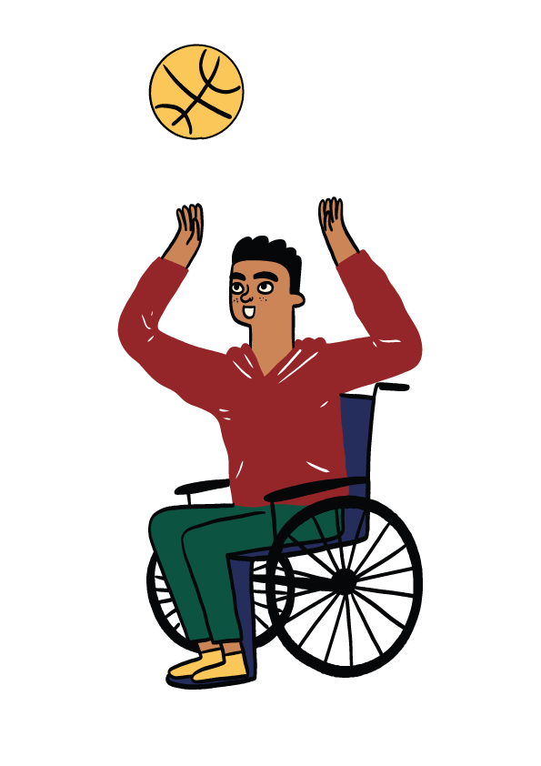
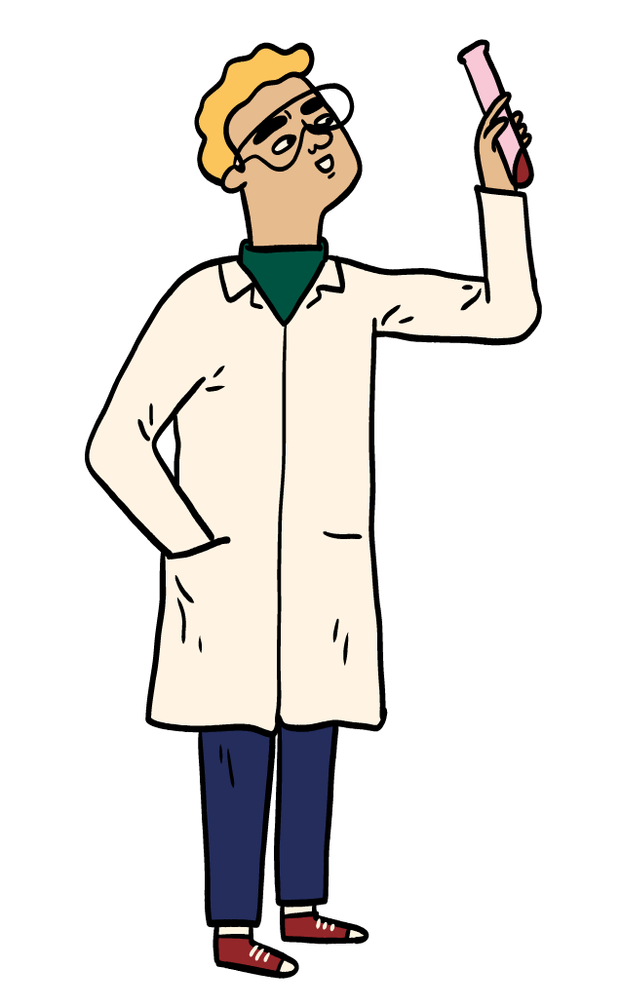
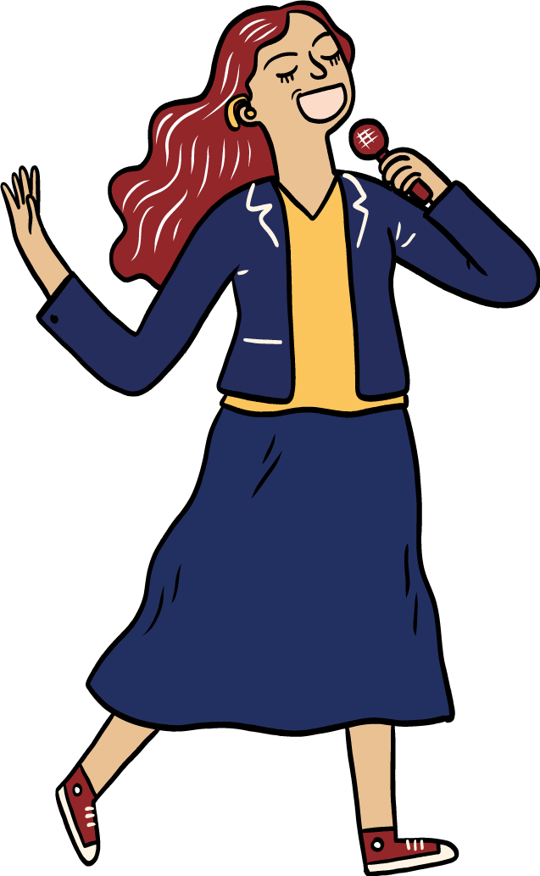

Your National Qualifications
What you need to know
Notes:
SQA has produced this year’s Your National Qualifications booklet which includes information about completing and submitting your coursework. Please download the full booklet at the end of presentation.

Slide 2


Information from SQA
Find out about the different National Qualifications and how they are assessed.
Understand more about assessment arrangements and how to put them in place.
Learn about different types of coursework as well as how to complete and submit yours.
Understand the rules and what happens if you break them.
Notes:
The ‘Your National Qualifications’ guide includes lots of useful information including information about:
The different types of National Qualifications and how they are assessed. Your teachers will also keep you right on what types of assessment you will do for each of your subjects.
Assessment arrangements should you have a disability or additional support needs.
The different types of coursework as well as how to complete and submit it – again your teachers will keep you right on what coursework you will have for each of your subjects.
It’s important that you read the information around the rules for creating and submitting your coursework. Please take time to understand these rules and speak to your teachers if you have any questions. There’s more about what happens if you break the rules later in the presentation.

Slide 3
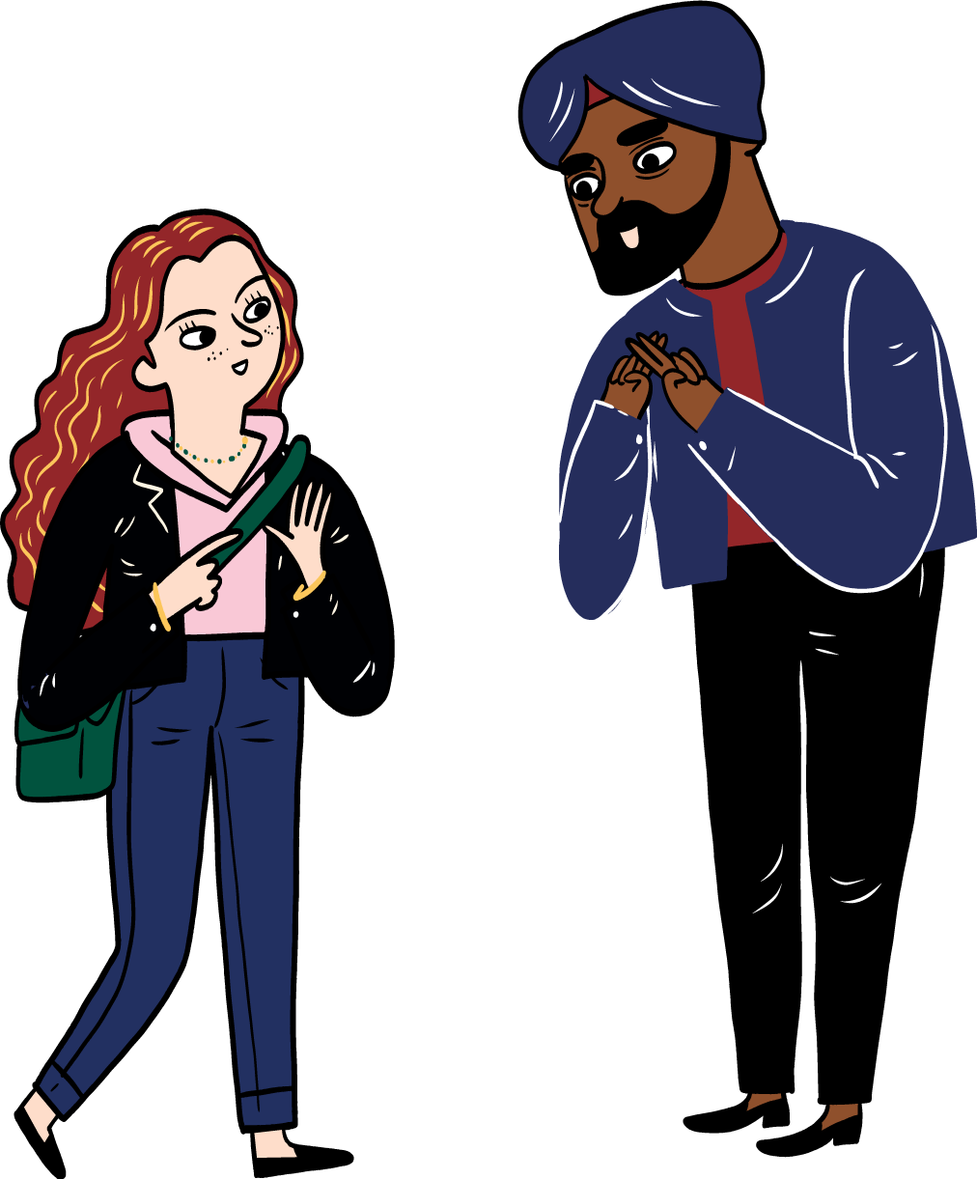
Assessment Arrangements
Assessment arrangements are adjustments that can be made to the assessment process. They:
are for learners who are disabled as well as those who have additional support needs.
allow learners to show the relevant knowledge, skills and understanding of the course.
can be put in place for coursework and performances, as well as exams.
^{Want to know more?}
Notes:
Assessment arrangements are adjustments that can be made to the assessment process. They enable learners who are disabled and those with additional support needs to show the relevant knowledge, skills and understanding of the course.
Assessment arrangements can be put in place for coursework and performances, as well as exams.
If you would like to know more about these arrangements, please speak to [centre staff to advise learner of who to speak to] as soon as possible so that they can discuss the most appropriate assessment arrangements with you. If you prefer, your parent or carer can speak to your teacher for you.

Slide 4

Doing your coursework
If you are using sources:
  Use ‘quotation marks’ around text
  Give a reference for diagrams
  Create a bibliography at the end of your work
  Check with your teacher
If there is a word count, you must stick to it.
If you have a resource sheet, you must hand it in.
Notes:
Sources
You may be able to use lots of different sources, including books, the internet and TV, in your work. Using different sources is a great way to learn, but it is important that you reference them correctly.
You can’t just copy information from other sources and include it as if it were your own work. You must keep a note of all material you use from other sources and where it is from so that you can tell it apart from your own work. Your teacher can tell you how to do this, but here are a few pointers.
Use ‘quotation marks’ around any text that has come from other sources, and clearly state where that text is from.
Provide a reference for any diagrams or illustrations you’ve used from other sources.
Create a bibliography (a list of sources you have used) if you’ve used other sources. This will go at the end of your work.
Word count
If your coursework states a minimum or maximum word count, you must stick to it – you could be penalised if you don’t. Make sure you speak to you teachers who will be able to tell you what the word count is for each of your subjects.
Resource sheets
In certain subjects you may be allowed to use resource sheets (also known as ‘research sheets’ or ‘processed information sheets’). Your teacher will tell you if you need to use one as part of your coursework and will show you how to use it. If you are not sure whether you will need to use one, speak to your teacher.
If you need to use a resource sheet, it’s important that you know the rules on how to use it because you could lose marks if you don’t use it correctly.
You must hand in your resource sheet with your coursework. If you don’t, you will automatically lose 20% of the marks for your coursework.

Slide 5
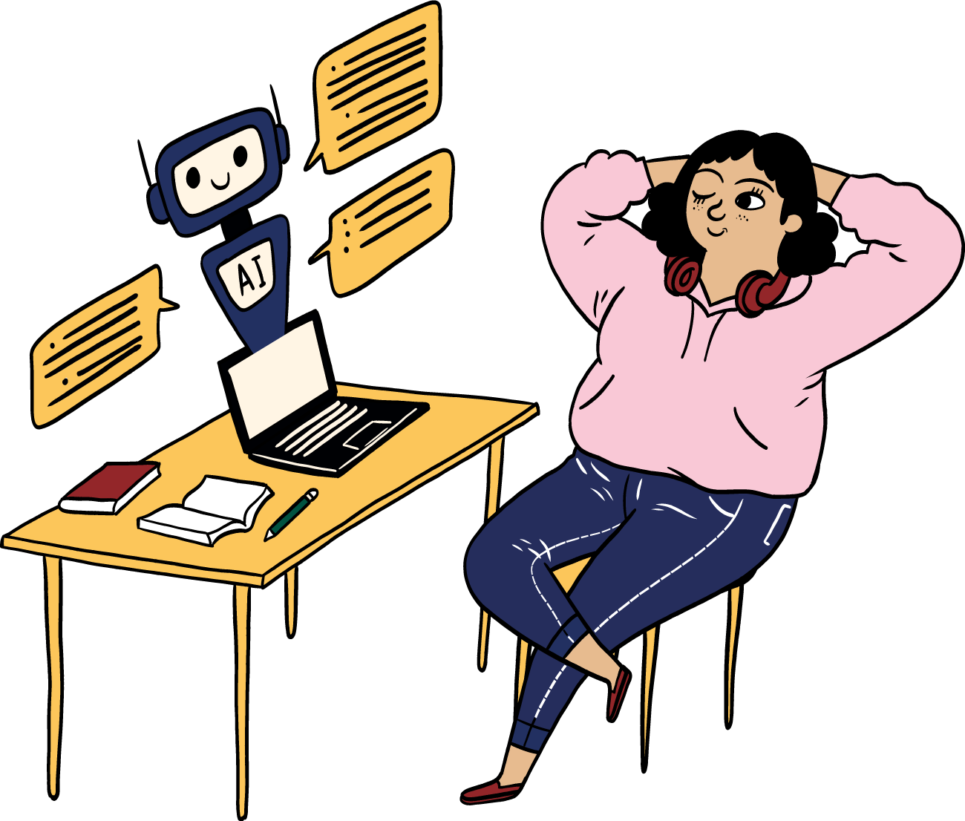
Artificial Intelligence (AI)
You must not use or reference AI tools as sources for your work.
Examples include ChatGPT and Google Bard
Many have age restrictions
They can create unreliable information
Notes:
You might have heard about or used artificial intelligence (AI) tools such as ChatGPT or Google Bard. Many of these AI tools have age restrictions, which means they are not suitable for everyone. The text they produce can be incorrect or contain biased information. As the information is not reliable, you must not use or reference AI tools as sources for your work.
You can speak to your teachers to find out more about sources you can use to complete your coursework and prepare for exams.

Slide 6
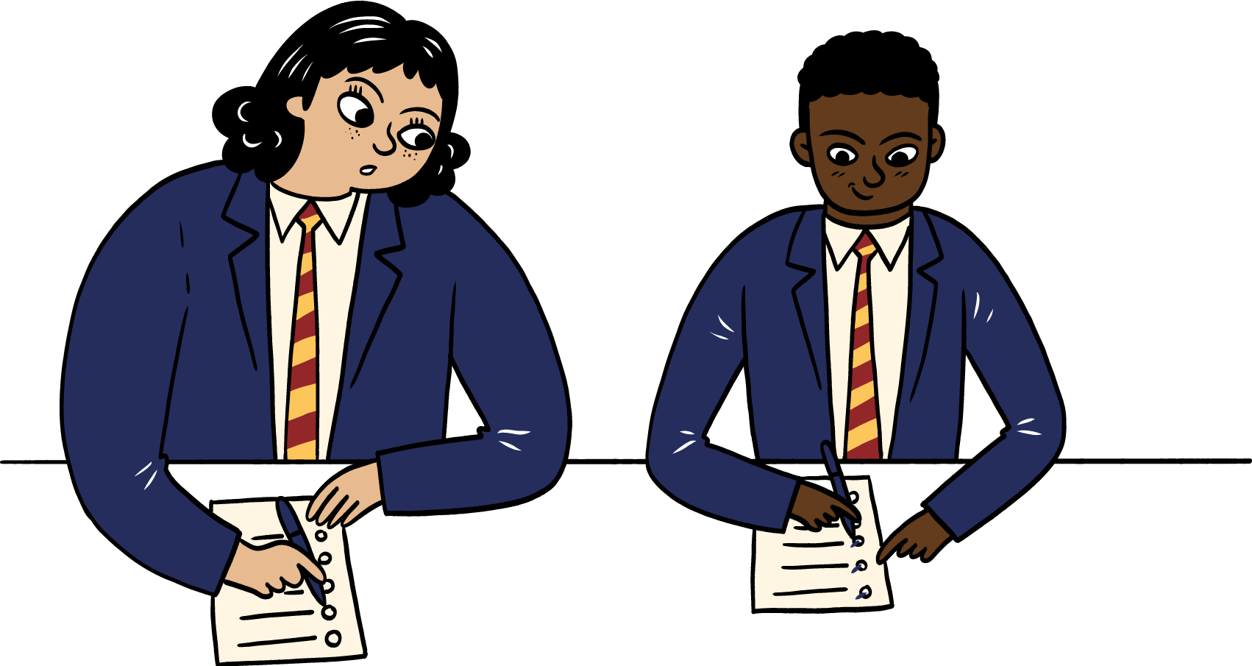
Plagiarism and collusion
Passing off other people’s work and ideas (or work produced by AI tools) as your own is called ‘plagiarism’ and it’s cheating.
^{It’s not your own work if:}
someone else has done all or any of the work – now or in the past
it’s example work prepared by your teacher
you’ve copied it from a book, website or an essay bank, or
you have copied work that has been produced by an AI tool and are passing it off as your own work.
Working with others when you should be working alone is called ‘collusion’. This includes giving and receiving help, as well as sharing files, passwords and paperwork
Notes:
Plagiarism: You must only submit your own work. Passing off other people’s work and ideas (or work produced by AI tools) as your own is called ‘plagiarism’ and it’s cheating.
If you don’t reference sources that’s also plagiarism.
Collusion: Working with others when you should be working alone is called ‘collusion’. This applies to giving help, getting help, and sharing files, passwords and paperwork.
Everyone involved in collusion is breaking the rules – not just the person who has asked for help. If another learner (for example, someone in your class) asks you for help, you should tell them to speak to the teacher.
If you are working as part of a group (for example, a group project), you must make sure that the written work you provide as part of the group work is your own.
If you are having difficulty with any part of your course, ask your teacher for advice. No other person can be involved, at any stage, in discussing or reviewing your coursework.

Slide 7

Don’t risk it
Spotting plagiarism and collusion isn’t difficult.
^{Your teachers know your work.}
Markers know their subject and lots of sources.
SQA uses software that identifies plagiarism and collusion.
The software also helps to identify work produced by AI tools.
Notes:
Spotting plagiarism and collusion isn’t difficult.
Teachers are familiar with your work and can spot changes in your writing style and the language you use.
Markers know their subject inside out, so they’re familiar with lots of sources.
We use software that identifies plagiarism, the use of AI, and collusion. This software matches copied phrases and text with the sources they’ve been taken from.

Slide 8
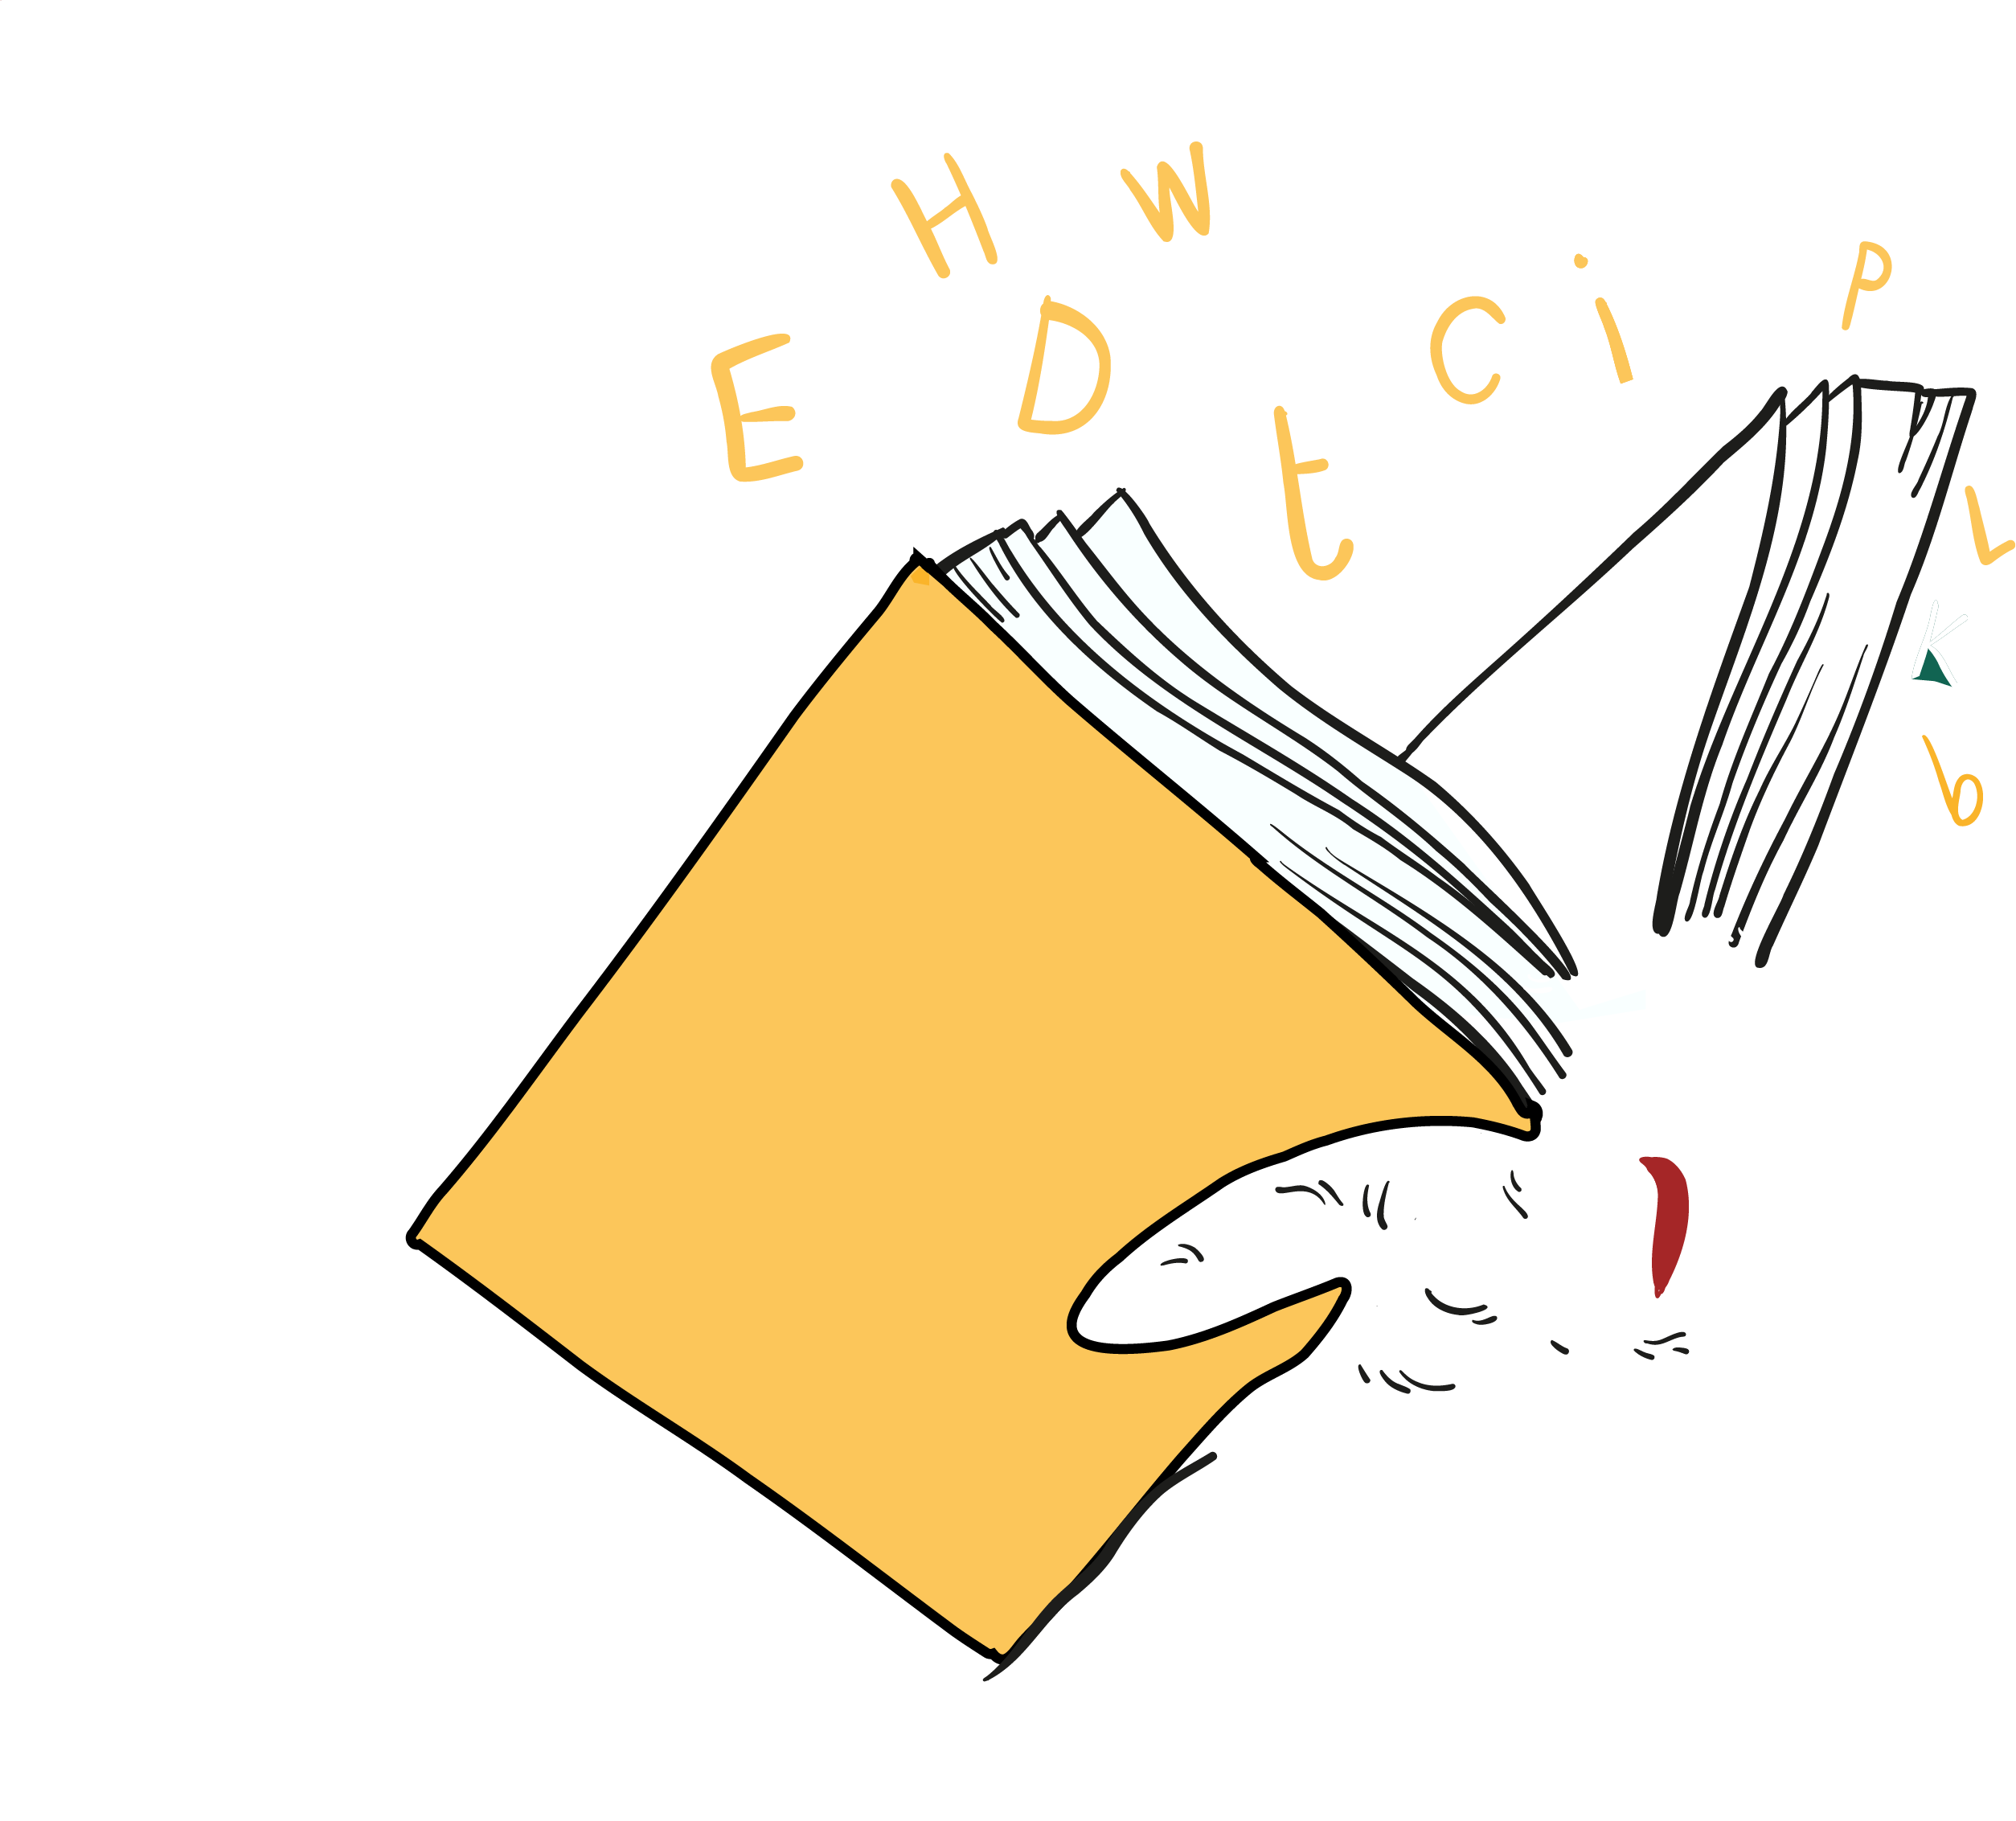
Language and writing
Written work
Markers might not be able to award marks if your writing is too difficult to read.
Markers will investigate the use of any language or images that is/are:
Rude
Offensive
Discriminatory
Notes:
Markers will do their best to read your work, but they might not be able to award marks if your writing is too difficult to read.
Don’t include rude, abusive, offensive or discriminatory language or images in your work. If you do, markers will investigate.
Remember that written coursework must be legible.

Slide 9
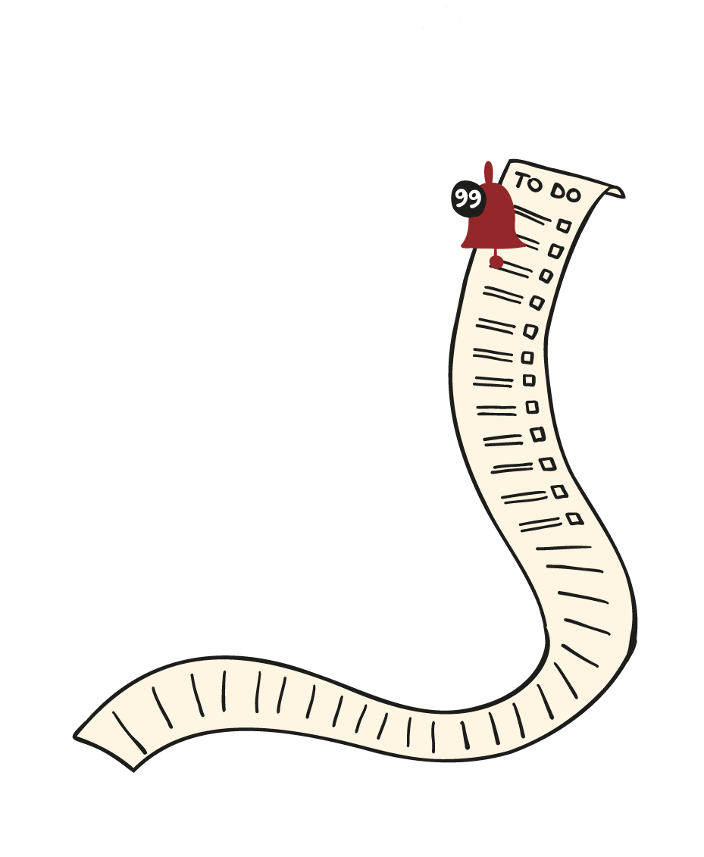
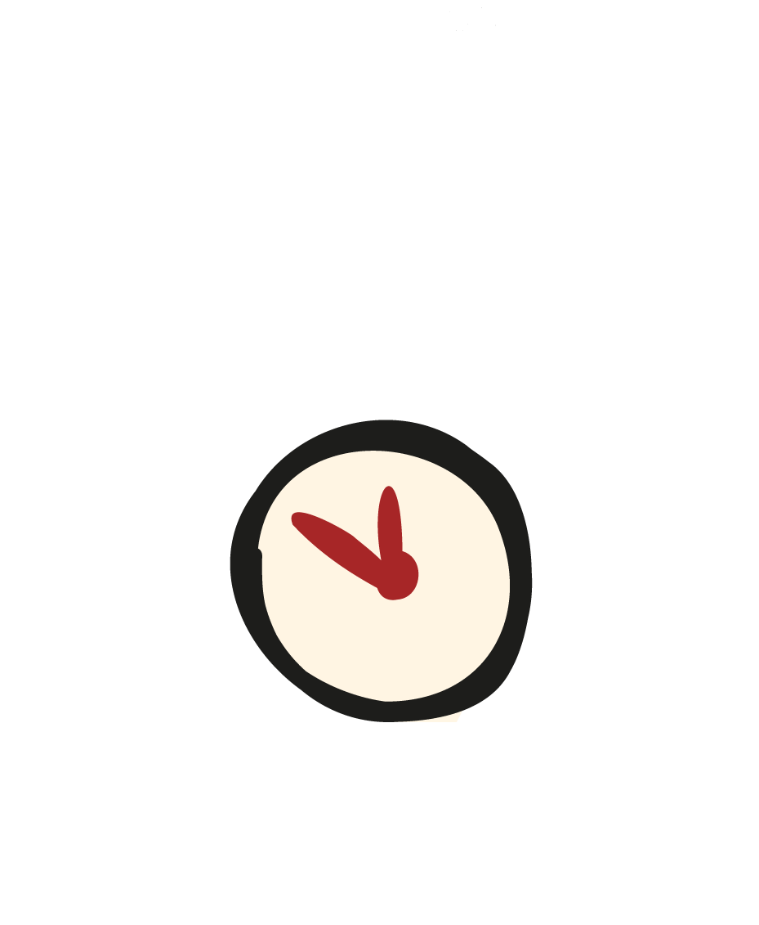

Handing in your coursework
Check your work. Make sure:
it’s your own work and has been referenced properly.
there’s no rude, abusive or offensive language or images.
you’ve completed it in line with the instructions your teacher gave you.
you’ve not included any material produced by AI.
Deadlines:
Make sure you stick to the deadline set by your teacher.
Notes:
Check your work
Before you hand in your coursework, you must look over it and check that:
everything is your own work, and you have properly referenced all sources of information, diagrams or illustrations you have used
there is no rude, abusive or offensive language or images
you have completed it in line with the instructions your teacher gave you
you have not included any material produced using an AI tool
Deadlines
Your teacher will set your coursework deadlines. It is important that you hand your work in before the deadline.
If you are struggling to meet a deadline, talk to your teacher as early as possible to see what they can do to help.

Slide 10
Handing in your coursework
Declaration – for you to sign and confirm that:
I have read SQA’s Your National Qualifications booklet and understand its contents.
I understand that SQA may reduce or cancel my grades where I have not followed the rules specified in the Your National Qualifications booklet.
the coursework submitted with this declaration is all my own work with all sources of information clearly identified and acknowledged.
where I have used a resource sheet, I have submitted it along with my coursework.
I understand that this coursework will be submitted to SQA for marking.
Notes:
Declaration
Before we send your coursework to SQA for marking, we will give you a declaration to sign. It’s really important that you understand the declaration. If you’re not sure about anything, ask your teacher.
This is the declaration you’ll need to sign.
I confirm that:
I have read SQA’s Your National Qualifications booklet and understand its contents.
I understand that SQA may reduce or cancel my grades where I have not followed the rules specified in the Your National Qualifications booklet.
the coursework submitted with this declaration is all my own work with all sources of information clearly identified and acknowledged.
where I have used a resource sheet, I have submitted it along with my coursework.
I understand that this coursework will be submitted to SQA for marking.
Note: if you plan to publish or share your work online, you must talk to us about this first.

Slide 11
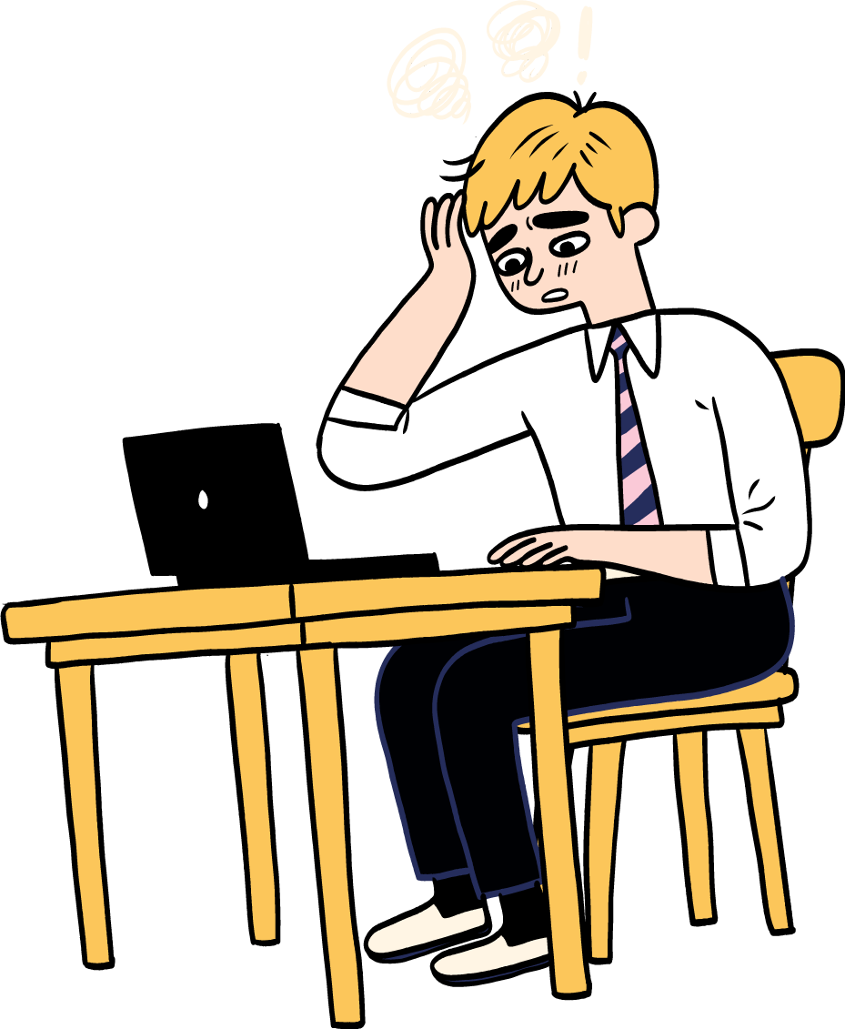
What if I break the rules?
Marks can be reduced
You could be awarded zero marks
Your qualification could be cancelled
All your qualifications for the year could be cancelled
Notes:
What if I break the rules?
If an investigation finds you’ve broken any rules, there may be a penalty, which could include the following.
Your marks can be reduced, or you can be awarded zero marks.
Your qualification for that subject can be cancelled.
All of your qualifications for the entire year can be cancelled.

Slide 12
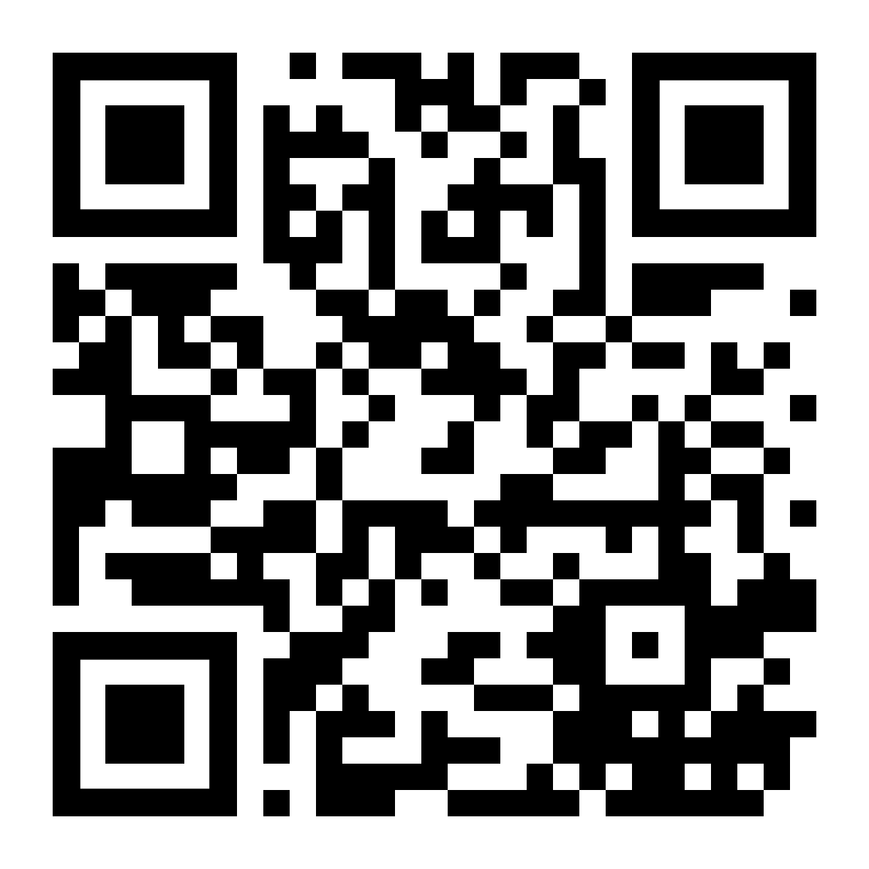
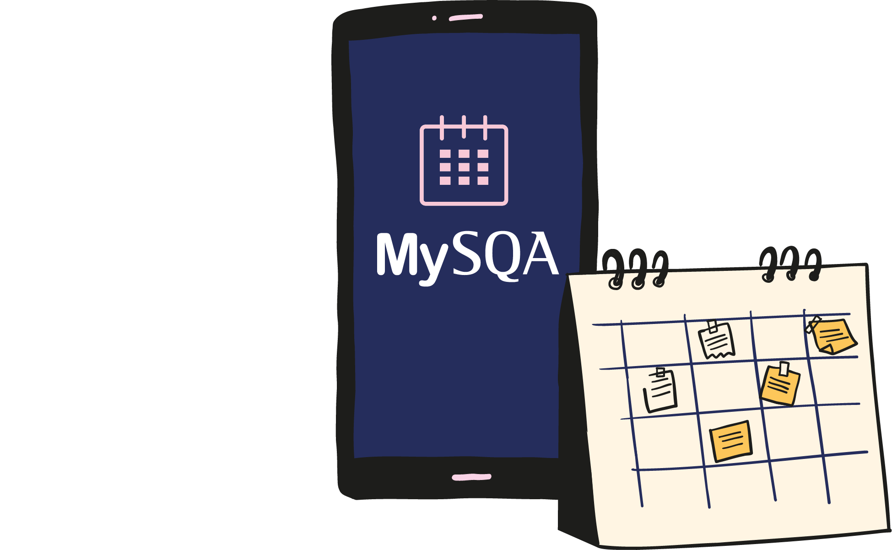
2025 Exams
Visit www.sqa.org.uk/timetable or scan the QR code
Download the MyExams app
The 2025 exams are 28 April to 2 June.
More information about what happens in the exams and what you need to do will be available in March 2025.
Notes:
You can see the exam timetable at www.sqa.org.uk/timetable. This shows the dates and times of your exams. You can also download our MyExams app to create and view your personal timetable, add notes and add your personal timetable to other calendars. The 2025 exams will take place from 28 April to 2 June. We’ll give you more information about your exams in March . We will tell you what happens in the exams and what you’ll need to do.

Slide 13
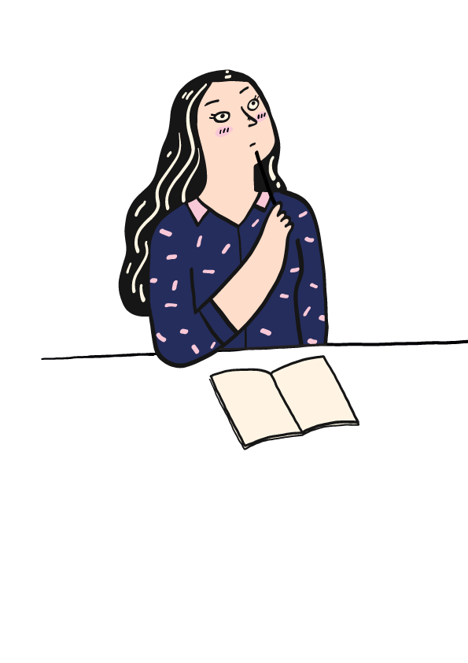
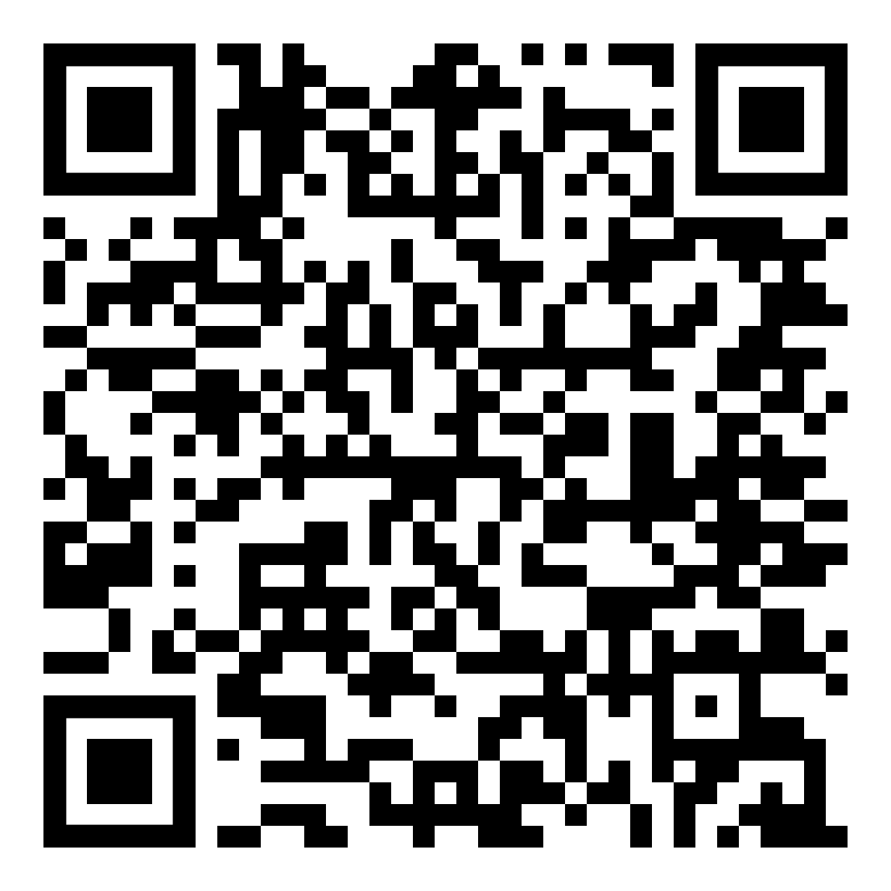
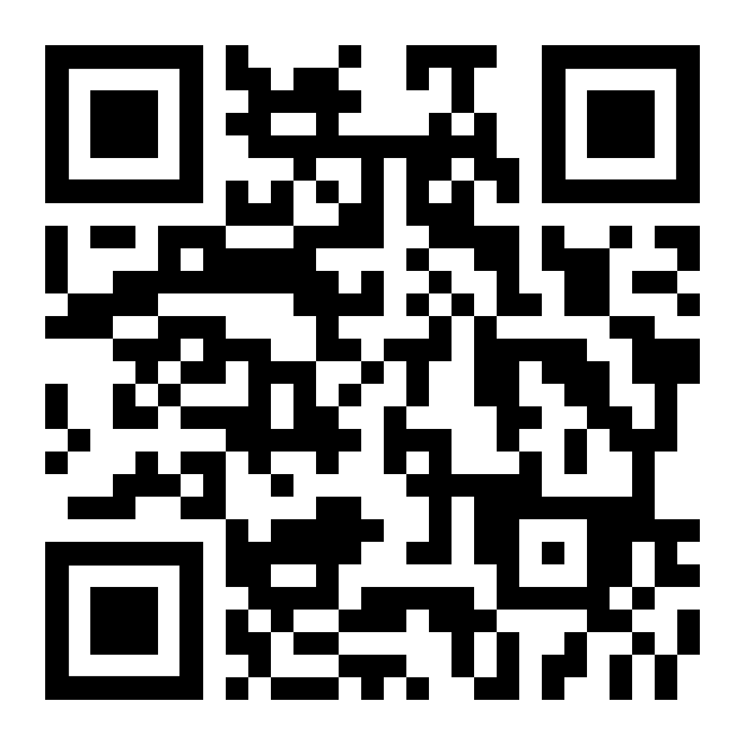
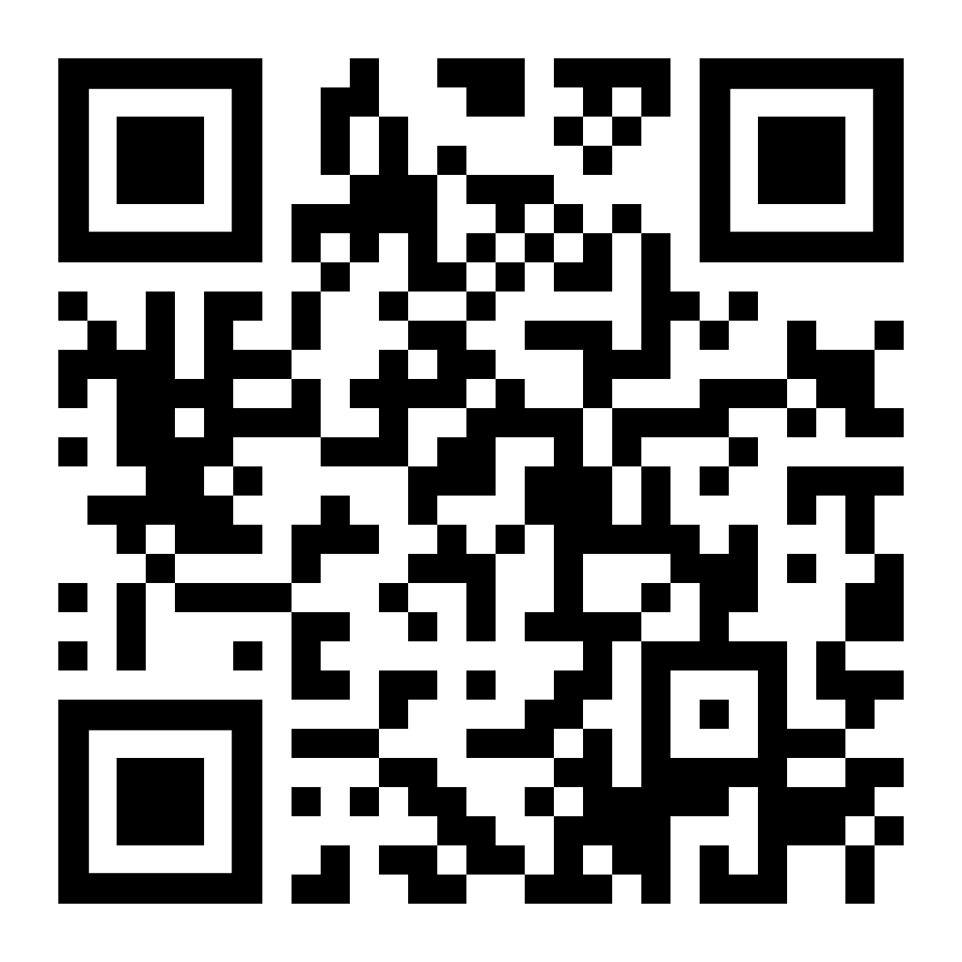
Help and support
Scan the QR code to download the full booklet
Stay up to date on the latest information from SQA at www.sqa.org.uk/learners
For more support, including who you can speak to if you’re feeling anxious, visit:
www.sqa.org.uk/learnersupport

Slide 14


