Slide 1

SQA qualifications in BSL to support the Senior Phase of the curriculum in Scotland

Slide 2

SQA qualification types relevant to the Senior Phase:
  Units - existing BSL Units (SCQF levels 3 – 6)
  Awards
  National Courses
“The senior phase of the new curriculum should be a mixed economy of provision”
More information on SQA Awards:
http://www.sqa.org.uk/sqa/41280.2540.html

Slide 3
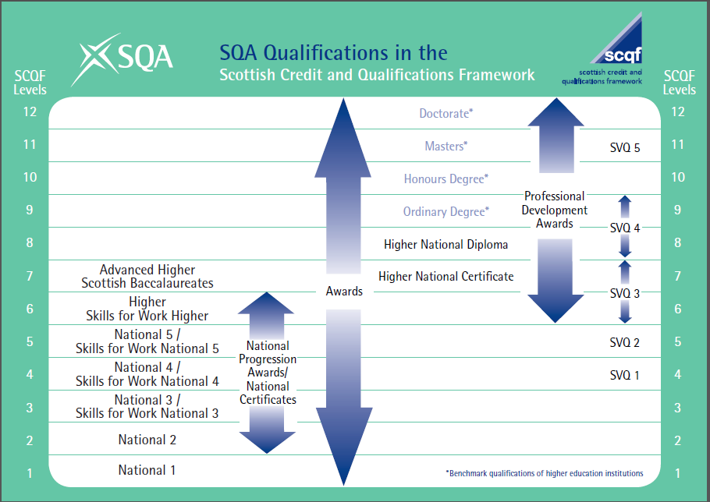

Slide 4
  How can SQA support the development of BSL in the curriculum?
  Short term:
  Review and promote existing Unit based qualifications
  Develop plans for the creation of new “Award” provision in BSL (SCQF levels 3 – 6)
    Develop and submit business case*
    Set up Design Team
    Develop and validate and launch new Awards in BSL (c2018)
    *Some external funding required.

Slide 5
  How can SQA support the development of BSL in the curriculum?
  Medium Term:
  With education partners – review the progress to date and measure against the criteria for the development of new National Course provision in languages.
  If all criteria met – create the business case and commence development of new National Couse provision.

Slide 6
  SQA criteria for adding a new language as a National Course
  Evidence of demand for a National course from language learners and delivering centers
  Sufficient qualified and registered teachers to develop deliver and assess the National Course.
  The strategic support from a range of partners within Scottish Education
  The availability of specific grant funding from the Scottish Government

