Slide 1
HN Administration and Information Technology Network Event
12th March 2020

Slide 2
Programme
Welcome and SQA Update
Senior External Verifier Update
Tea/coffee Networking break (30 mins)
Microsoft Teams
Lunch (12.00)
Developing Digital Assessment
Plenary
Close (circa 14.15)

Slide 3
Qualifications Officer
Caitlin Boyle Caitlin.boyle@sqa.org.uk
Qualifications Officer
HN/SVQ Business, Administration and Enterprise

Slide 4
SQA Update – 2019/20
Revised Optional Units
Research Skills J1NC 34 (F60A 34 ends 31.07.22)
Recruitment, Selection and Induction J2FS 34 (H1XK ends 31.07.21)
Interviewing: Skills and Practice J2FK 34 (H1XM ends 31.07.21)
HRM: Introduction J2FH 34 (H1KP 34 ends 31.07.21)

Slide 5
SQA Update – Graded Unit 1
Two new versions of Paper 1 (MC/MR questions) created.
Two fixed paper ASPs
Two fixed SOLAR Paper 1 Assessments
MR questions now identified

Slide 6
SQA Update – Graded Unit 1 changes
Minimum threshold scores for Paper 1 and Paper 2 have been removed. The rationale for this change is as follows: .
Exam is one assessment with provision for a break not two separate assessments .
The Graded Unit is a synoptic assessment, it is not intended to re-assess knowledge from units already achieved .
The five units covered in each paper are the same .
Removes a potential barrier in terms of effectively having to achieve two pass marks .
Aligns with other Administration and IT (GU2) and Business Graded Unit examinations

Slide 7
SQA Update – Entry & Cert Stats

Slide 8
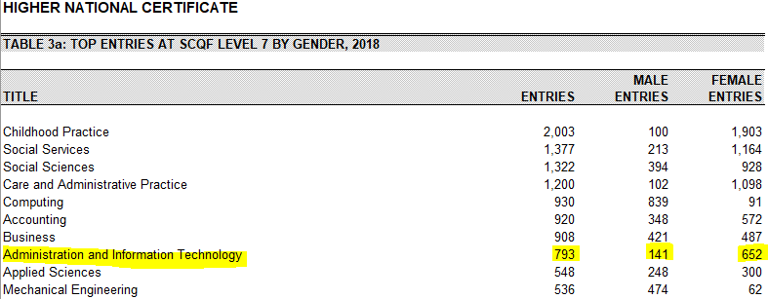
SQA Update – Entry & Cert Stats

Slide 9
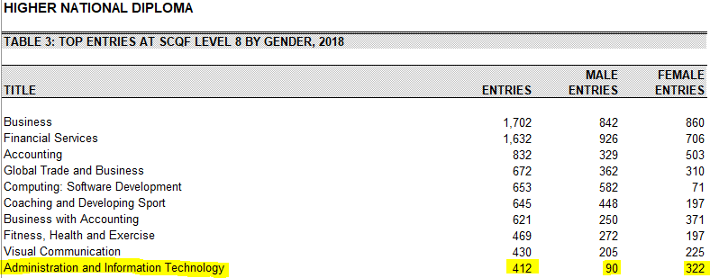
SQA Update – Entry & Cert Stats

Slide 10
Questions?

