Slide 1
HN Business Network Event
6th March 2020

Slide 2
Programme
Welcome and SQA Update
Senior External Verifier Update
Business Enterprise programme
Tea/coffee
Digital and Social Technologies in Business
Lunch (13.00)
Developing Digital Assessment
HN Business Review Update
Plenary
Close (circa 15.45)

Slide 3
Qualifications Officer
Caitlin Boyle Caitlin.boyle@sqa.org.uk
Qualifications Officer
HN/SVQ Business, Administration and Enterprise

Slide 4
SQA Update – 2019/20
Revised Optional Units
Research Skills J1NC 34 (F60A 34 ends 31.07.22)
Recruitment, Selection and Induction J2FS 34
(H1XK ends 31.07.21)
Interviewing: Skills and Practice J2FK 34
(H1XM ends 31.07.21)
HRM: Introduction J2FH 34 (H1KP 34 ends 31.07.21)

Slide 5
SQA Update – 2019/20
Optional Units Added
Public Relations: Principles and Practice HC2P 34
Contemporary Marketing Issues DV8G 34
Marketing: Brand Management HC4A 35

Slide 6
SQA Update – Graded Unit 1
Case study should be given to learners up to 3 weeks prior to the examination
The examination should be unseen and the assessment should be conducted in controlled and invigilated conditions
Learners may not bring their own copy of the case study, centre must provide a fresh copy
Assessors may provide advice and guidance on examination technique and clarification on the meaning of command words, which may appear within an examination, prior to the examination
[new statement] Content of case study must not be discussed with learners prior to assessment

Slide 7



SQA Update – Entry & Cert Stats

Slide 8
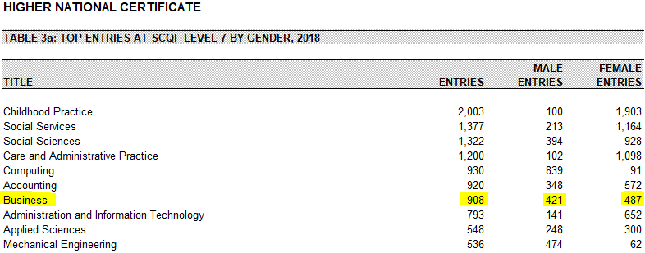
SQA Update – Entry & Cert Stats

Slide 9
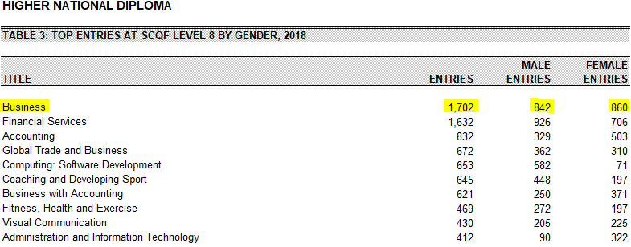
SQA Update – Entry & Cert Stats

Slide 10
Questions?

