Slide 1
Microsoft Teams
Vickie Craig
Learning and Digital Resources Lead

Slide 2
D&A Digital Strategy

Slide 3
Learning and Digital Resources Lead Role
Is a bespoke role within the Learning and Digital Resources Team which supports both staff and the learner with:
Learner
Academic writing
Referencing
Interview Skills
Digital CV Writing
Internet Safety
Digital skills
Any other digital skills training
Staff
Virtual learning environment (VLE)
ePortfolios
eAssessment
Digitising learning materials
Bespoke recruitment assessments
Microsoft Teams
Any other digital skills training

Slide 4
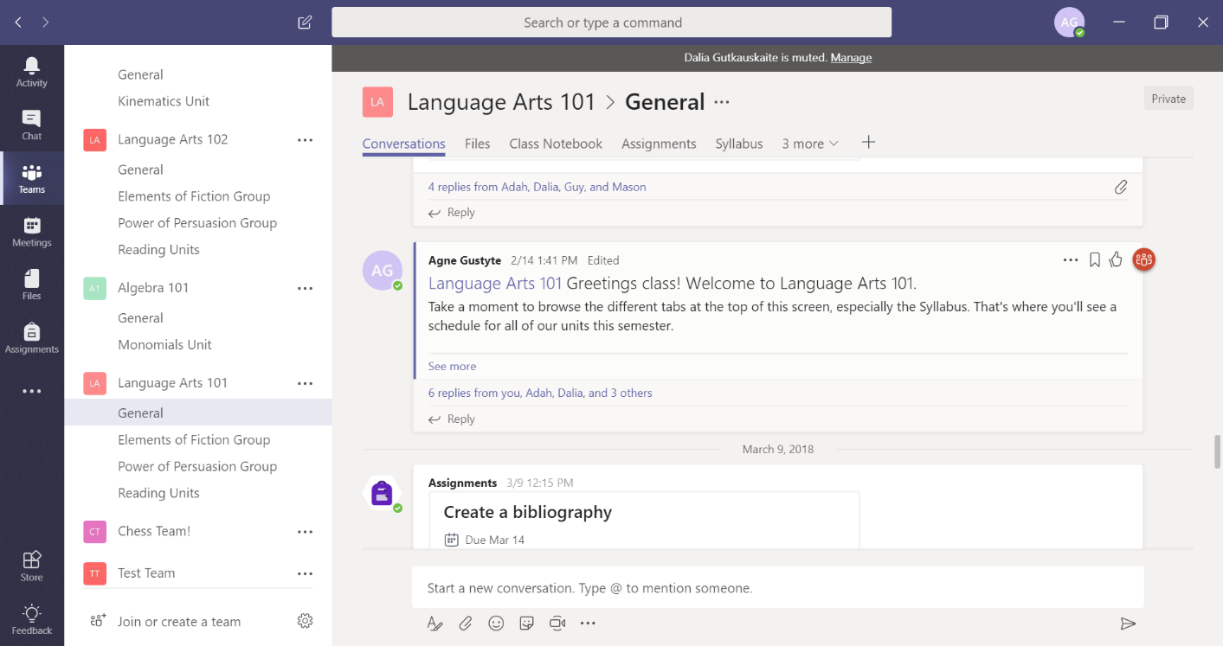
So what is Microsoft Teams?
Microsoft Teams is a system developed by Microsoft, for users to communicate and collaborate in specific spaces called a Team. A Team can be create for a department, a project, a working group, and/or group of students.

Slide 5
Microsoft Teams Training
Over the past few months we have rolled out Microsoft Teams training to approximately 22 departments within the College.
Some of these include:
Business (Academic)
Essential Skills (Academic)
Health and Social Care (Academic)
Administration (Support)
Developing the Young Workforce (Support)

Slide 6
Main features of Microsoft Teams
Instant messaging facility (one-to-one and or custom groups)
Video conferencing with recording function
Video calling
Central storage area for files and documents
Create and edit Microsoft files within Teams e.g. Word
Syncs with Microsoft Outlook calendar
Syncs with OneDrive/Sharepoint
Ability to add other Microsoft packages for easy access e.g. OneNote, Planner, Forms and more
An assignment upload area for students (Turnitin is coming!)

Slide 7
What we have found…
A reduction in emails
More opportunity to collaborate
Less campus travelling
An increase in operational efficiencies
A reduction in numerous document versions
To be able to conduct meetings virtually and record
An easy to use file sharing system
An automated data backup

Slide 8
Microsoft Teams Student Pilot
In recent months we have been working with the HNC Admin and IT Distance Learning and Essential Skills Teams to roll out Microsoft Teams for Students. These students are distance learning and are not in campus.
It allows them to:
Access course materials
Participate in online class lectures
Chat instantly
Collaborate on files
Gradebook overview of assessments
Upload assignments
Use Microsoft Forms quiz feature for formative assessment

Slide 9
How do I access Teams?
Microsoft Teams is available for those who have the Microsoft Office 365 Education licence.
Microsoft Teams is installed on all PCs across our three campuses. It can be accessed via an internet browser by going to teams.microsoft.com.
For those who have access to a mobile device, an App is available by searching for Microsoft Teams within the App Store.

Slide 10
Navigating around Teams

Slide 11
Navigating around Teams

Slide 12
Navigating around Teams
Activity
Chat
Teams
Meetings
Files
Assignments
More

Slide 13
Navigating around Teams

Slide 14
Navigating around Teams

Slide 15
Navigating around Teams

Slide 16
Navigating around Teams

Slide 17
Navigating around Teams

Slide 18
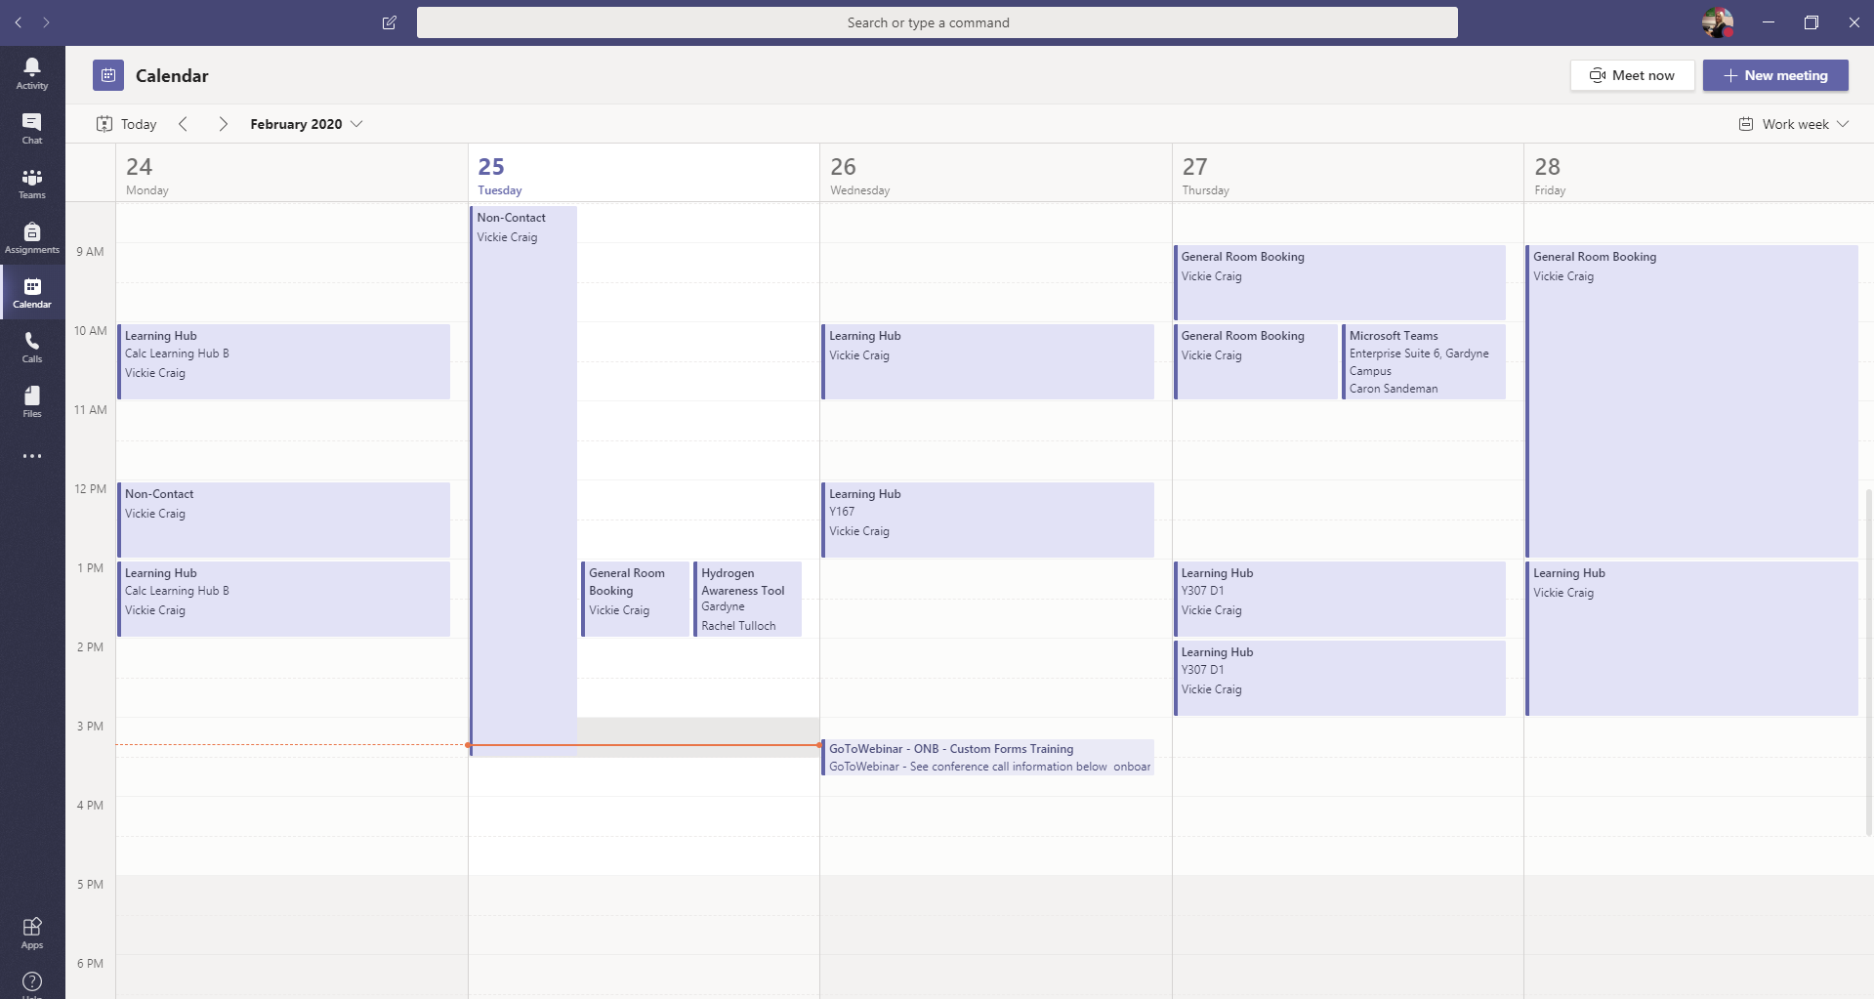
Video Conferencing & Online Class Lectures

Slide 19
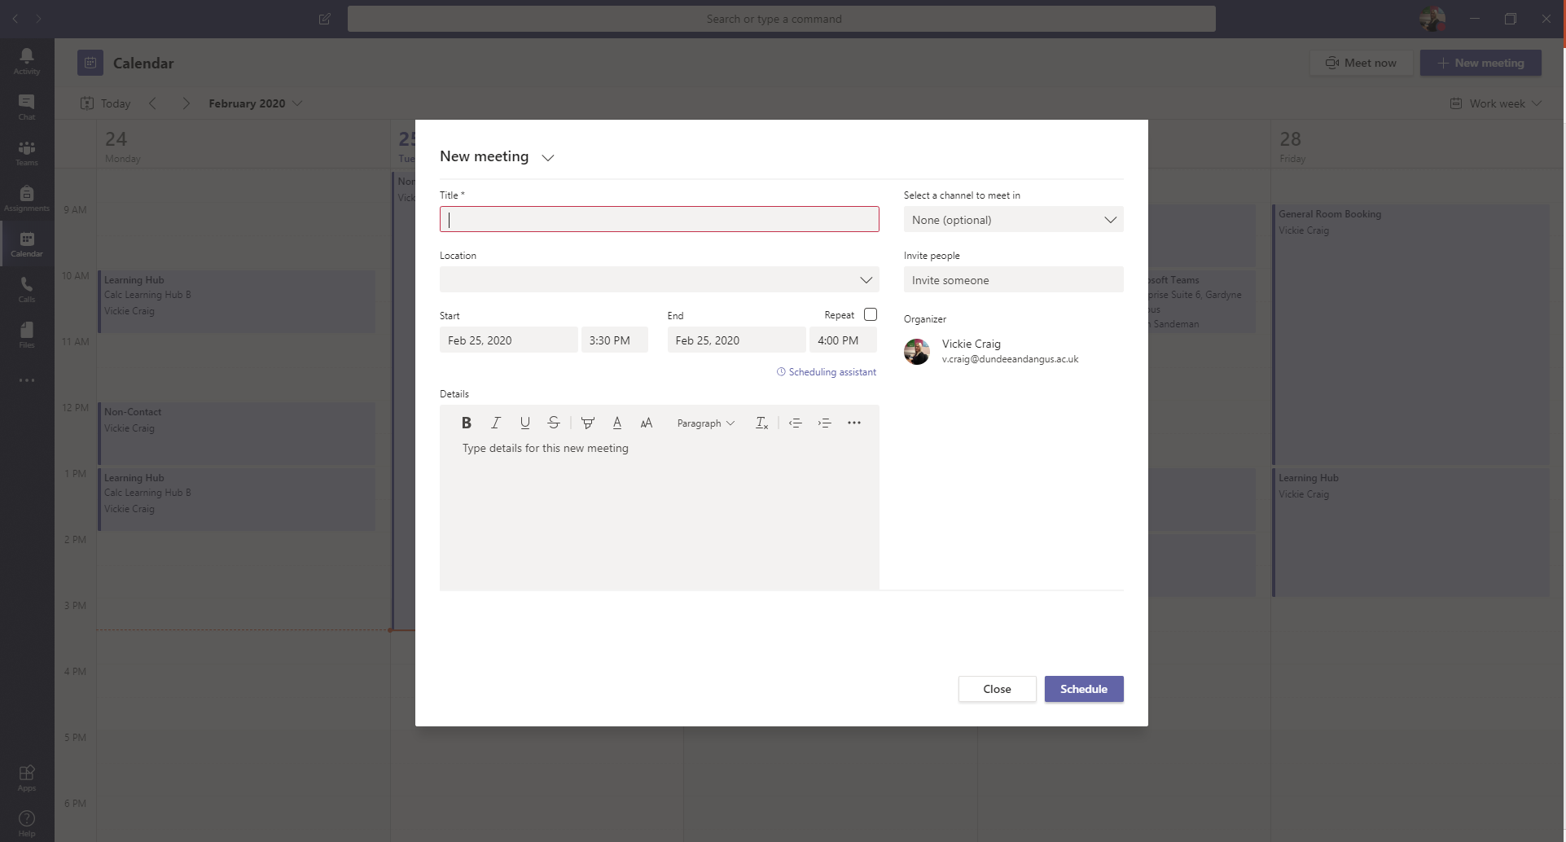
Video Conferencing & Online Class Lectures

Slide 20
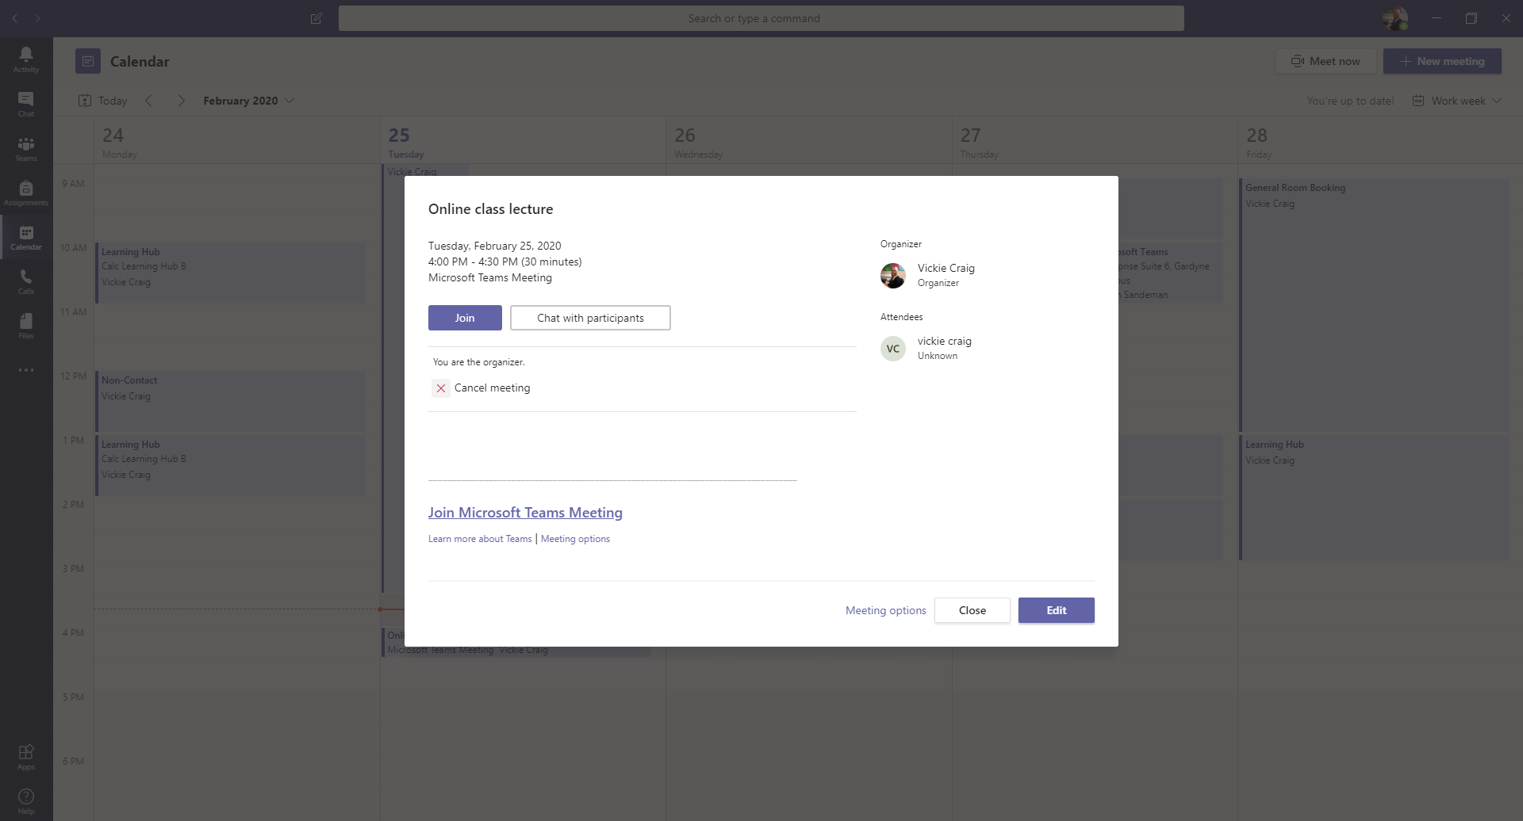
Video Conferencing & Online Class Lectures

Slide 21
Video Conferencing & Online Class Lectures

Slide 22
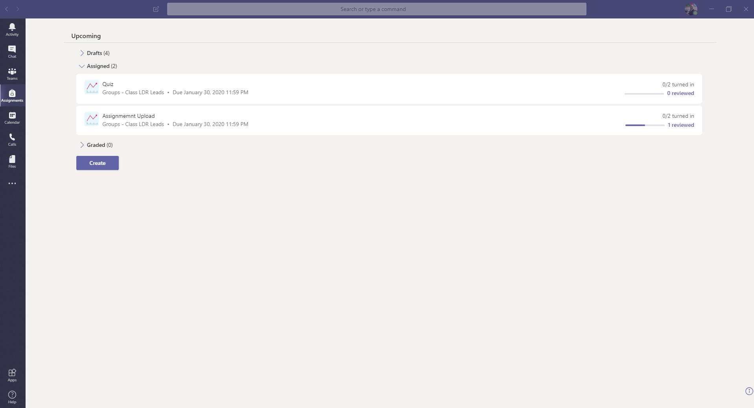
Assignments (Gradebook)

Slide 23
Help Guides
Comprehensive help guides have been created in the format of online, paper and presentation for:
General Microsoft Teams (including uploading and editing files and video conferencing)
Microsoft Teams for Students (staff guide)
Microsoft Teams for Students (student guide)

Slide 24
Our next steps
Introduction of Ways of Working Champions
Continue to provide general training to all staff
Test Turnitin assignments and roll this out
Support further eAssessment within Teams
Roll out Microsoft Planner feature
Continue to look for new ways of working
Pilot and test for potential projects
To move all distance learning student courses from VLE to Teams

Slide 25
Any questions?

