Slide 1


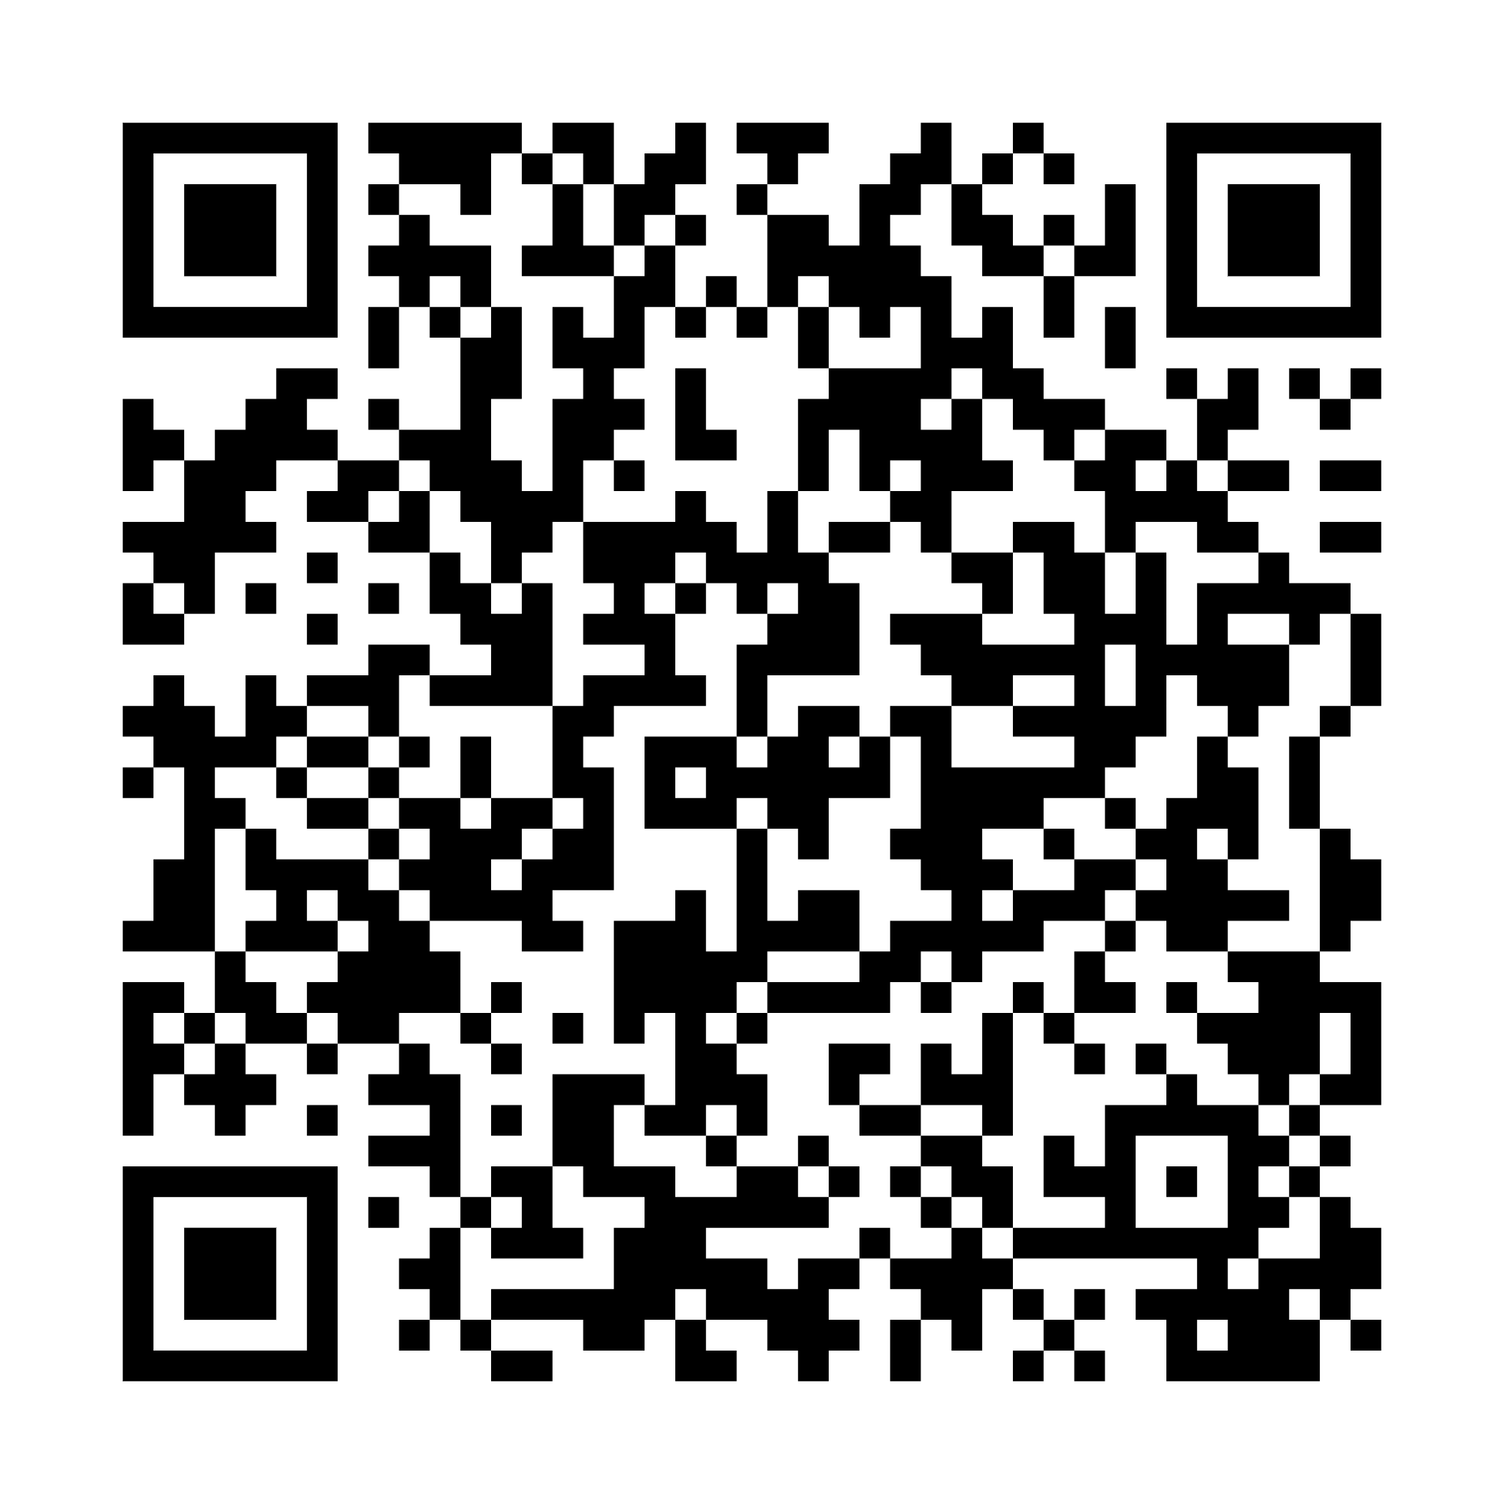

Your
National
Qualifications
What you need to know about National 5, Higher and Advanced Higher coursework.
Notes:
Qualifications Scotland has produced this year’s Your National Qualifications booklet which includes information about completing and submitting your coursework. Please download the full booklet at the end of presentation.

Slide 2




Information from Qualifications Scotland
  Find out about the different National Qualifications and how they are assessed.
  Understand more about assessment arrangements and how to put them in place.
  Learn about different types of coursework as well as how to complete and submit yours.
  Understand the rules and what happens if you break them.
Notes:
The ‘Your National Qualifications’ guide includes lots of useful information including information about:
The different types of National Qualifications and how they are assessed. Your teachers will also keep you right on what types of assessment you will do for each of your subjects.
Assessment arrangements, should you have a disability or additional support needs.
The different types of coursework as well as how to complete and submit it – again your teachers will keep you right on what coursework you will have for each of your subjects.
The information on the rules for creating and submitting your coursework is extremely important. Please take time to understand these rules and speak to your teachers if you have any questions. There’s more about what happens if you break the rules later in the presentation.

Slide 3

Assessment Arrangements
Assessment arrangements are adjustments that can be made to the assessment process.
  They are for learners who are disabled as well as those who have additional support needs.
  They allow learners to show the relevant knowledge, skills and understanding of the course.
  They can be put in place for coursework and performances, as well as exams.
Notes:
Assessment arrangements are adjustments that can be made to the assessment process. They enable learners who are disabled and those with additional support needs to show the relevant knowledge, skills and understanding of the course. You don't need a formal diagnosis from a medical professional to receive this support.
Assessment arrangements can be put in place for coursework and performances, as well as exams.
If you would like to know more about these arrangements, please speak to [centre staff to advise learner of who to speak to] as soon as possible so that they can discuss the most appropriate assessment arrangements with you. If you prefer, your parent or carer can speak to your teacher for you.

Slide 4

Coursework rules –
Cheating: plagiarism
If you are using sources:
  Use ‘quotation marks’ around text and say where it’s from
  Give a reference for diagrams or illustrations
  Create a bibliography (list of sources) at the end of your work
  Don’t use text created by GenAI
  Check with your teacher
If there is a word count, you must stick to it. If you have a resource sheet, you must hand it in.
Notes:
Sources
You may be able to use lots of different sources, including books, the internet and TV, in your work. Using different sources is a great way to learn, but it is important that you reference them correctly.
You can’t just copy information from other sources and include it as your own work. You must keep a note of all material you use from other sources and where it is from so that you can tell it apart from your own work. Your teacher can tell you how to do this, but here are a few pointers.
Use ‘quotation marks’ around any text that has come from other sources and clearly state where that text is from.
Provide a reference for any diagrams or illustrations you’ve used from other sources.
Create a bibliography (a list of sources you have used) if you’ve used other sources. This will go at the end of your work.
Don’t use GenAI tools as an independent source of information.
Word count
If your coursework states a minimum or maximum word count, you must stick to it – you could be penalised if you don’t. Make sure you speak to you teachers who will be able to tell you what the word count is for each of your subjects.
Resource sheets
In certain subjects you may be allowed to use resource sheets (also known as ‘research sheets’ or ‘processed information sheets’). Your teacher will tell you if you need to use one as part of your coursework and will show you how to use it. If you are not sure whether you will need to use one, speak to your teacher.
If you need to use a resource sheet, it’s important that you know the rules on how to use it because you could lose marks if you don’t use it correctly.
You must hand in your resource sheet with your coursework. If you don’t, you will automatically lose 20% of the marks for your coursework.

Slide 5


Coursework rules –
Cheating: collusion
Working with others when you should be working alone is called 'collusion’.
This includes:
giving or receiving help
sharing files, passwords or work.
Everyone involved in collusion is breaking the rules.
Notes:
Collusion
Working with others when you should be working alone is called ‘collusion’. This includes giving or receiving help, and sharing files, passwords or work.
Everyone involved in collusion is breaking the rules, not just the person asking for help. If another learner asks you for help, tell them to speak to their teacher instead.
If you are completing group work, make sure your written work is your own.
If you find any part of your course difficult, ask your teacher for advice. No one else can be involved in discussing or reviewing your coursework.

Slide 6

Don’t risk it
Spotting plagiarism and collusion isn’t difficult.
  Your teachers know your work.
  Markers know their subject and lots of sources.
  Qualifications Scotland uses software that identifies plagiarism and collusion.
  The software also helps to identify work produced by GenAI.
1
2
3
4
Notes:
Spotting plagiarism and collusion isn’t difficult.
Teachers are familiar with your work and can spot changes in your writing style and the language you use.
Markers know their subject inside out, so they’re familiar with lots of sources.
Qualifications Scotland uses software that identifies plagiarism, the use of GenAI, and collusion. This software matches copied phrases and text with the sources they’ve been taken from.

Slide 7


Artificial intelligence (AI)
You must not use or reference GenAI tools, such as Chat GPT and Google Gemini as sources of your work.
GenAI can be helpful for researching topics for coursework.
You must still show your knowledge and skills and submit your own work for marking.
Text created by a GenAI tool is not your own work, even if you reword it.
Notes:
You might have heard about or used generative artificial intelligence (GenAI) tools such as ChatGPT or Google Gemini. The text they produce can be incorrect or contain biased information. As the information is not reliable, you must not use or reference GenAI tools as sources for your work.
If you use assistive AI tools to help with your spelling and grammar, you must not use them primarily to re-write or translate work. The words you submit must be your own.
You can speak to your teachers to find out more about sources you can use to complete your coursework and prepare for exams.

Slide 8

Language, writing and images
Written work must be legible.
Use a pen with black or blue ink.
Don’t use gel pens or pencils.
Markers will investigate the use of any language or images that is/are rude, offensive, abusive or discriminatory.
Notes:
Written coursework must be legible. Markers will do their best to read your work, but they might not be able to award marks if your writing is too difficult to read.
You must use a pen with black or blue ink.
Don’t use gel pens or pencils as these can fade or smudge if your coursework is scanned.
Don't include rude, abusive, offensive or discriminatory language or images in your work. If you submit work that includes discriminatory material, such as racist or sexist content, the people who are marking your work will report it.

Slide 9


Handing in your coursework
Make sure:
it’s your own work and has been referenced properly.
there’s no rude, abusive, offensive or discriminatory language or images.
you’ve followed your teacher’s instructions.
you’ve not included any material produced by GenAI.
Deadlines:
You must stick to the deadline set by your teacher.
Notes:
Check your work
Before you hand in your coursework, you must look over it and check that:
everything is your own work, and you have properly referenced all sources of information, diagrams or illustrations you have used
there is no rude, abusive, offensive or discriminatory language or images
you have completed it in line with the instructions your teacher gave you
you have not included any material produced using a GenAI tool
Deadlines
Your teacher will set your coursework deadlines. It is important that you hand your work in before the deadline.
If you’re struggling to meet a deadline, talk to your teacher as soon as you can.

Slide 10

Handing in your coursework – declaration
For you to sign and confirm that:
I have read and understood Qualification Scotland’s Your National Qualifications booklet.
I understand that Qualifications Scotland may reduce or cancel my grades where I have not followed the rules.
the coursework submitted with this declaration is all my own work and I have identified all sources of information.
I have submitted all the required work, including any resource sheets or other type of information sheet relevant to my subject.
I understand that this coursework will be submitted to Qualifications Scotland for marking.
Notes:
Declaration
Before we send your coursework to Qualifications Scotland for marking, we will give you a declaration to sign. It’s really important that you understand the declaration. If you’re not sure about anything, ask your teacher.

Slide 11

What if I break the rules?
Marks can be reduced
You could be awarded zero marks
Your qualification could be cancelled
You could receive a written warning or be disqualified from taking Qualifications Scotland courses in the following year.
Notes:
What if I break the rules?
If a Qualifications Scotland or school investigation finds you have broken any rules, you may face a penalty. Penalties can include:
Your marks can be reduced, or you can be awarded zero marks.
Your qualification can be cancelled.
You may receive a written warning or be disqualified from taking Qualifications Scotland courses in the following year.

Slide 12


Exams
Visit qualifications.gov.scot
Download the MyExams app
The 2027 exams are 26 April to 3 June
Information about what happens in the exams and what you need to do will be available in March 2027.
Notes:
You can find the exam timetable under the learner support section of the Qualifications Scotland website – www.qualifications.gov.scot.This shows the dates and times of your exams.
You can also download the MyExams app to create and view your personal timetable, add notes and add your personal timetable to other calendars.
The 2027 exams will take place from 26 April to 3 June.
More information about your exams will be available in March.

Slide 13
Support
Scan the QR code to download the full booklet
For more support, including who you can speak to if you’re feeling anxious, visit: www.qualifications.gov.scot

